Slide 1
Homework Assignment #3 Matrix Multiplication in Multi-Thread
Professor： Hsung-Pin Chang
TA ：Wei-Xuan Nee

Slide 2
Outline
Thread Overview
POSIX Thread
- Creating Threads
- Exit threads
- Join threads
Exercise

Slide 3
Outline
Thread Overview
POSIX Thread
- Creating Threads
- Exit threads
- Join threads
Exercise

Slide 4
Why We Need Threads?
A traditional process
Needs a fair amount of "overhead“
Has a single thread of control
If the process has multiple threads of control, it can do more than one task at a time.
Threads
Run as independent entities because they duplicate only the bare essential resources that enable them to run code

Slide 5
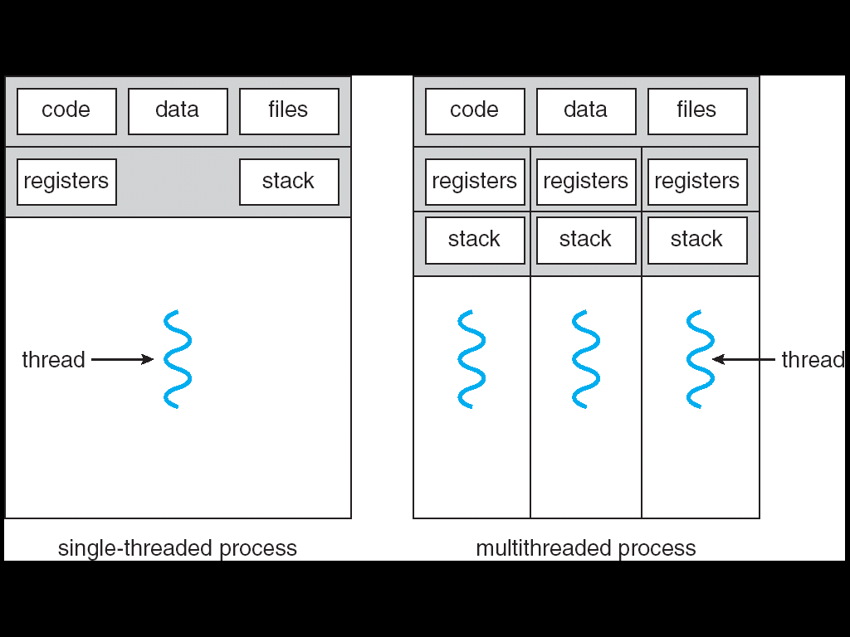
What Is a Thread?

Slide 6
What Is a Thread?(cont.)
A thread is a flow of control within a process.
A multithreaded process contains several different flows of control within the same address space.
A thread has a thread ID, a program counter, a register set, and a stack, and is similar to a process has.
However, a thread shares with other threads in the same process its code section, data section, and other OS resources.
Thus, thread is lightweight

Slide 7
The Benefits of Multithreaded Programming
Responsiveness
A process can execute even if some part of process is paused or taking a long time.
Resource sharing
Share resources of the process to which they belong.
Economy
Allocating memory and resources for process creation is costly.
Threads that share resources of the process to which they belong is more economical to create and context switch threads.
Great on multiprocessor architectures
Be greatly increased in a multiprocessor architecture.

Slide 8
Challenges When Using Thread
Because threads within the same process share resources:
Changes mode by one thread to shared system resources will be seen by all other threads.
Reading and writing to the same memory locations at the same time by two different thread is possible
Race condition
Therefore, thread needs explicit synchronization by the programmer.

Slide 9
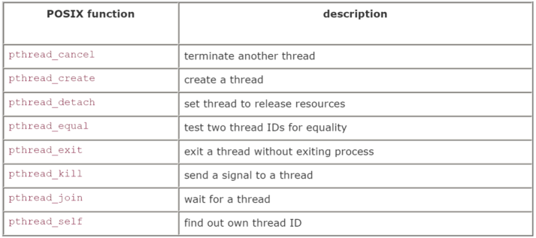
The Pthreads API
There is a whole set of library calls associated with threads, most of whose names start with pthread_.
To use these library calls, we must include the file pthread.h, and link with the pthread library using -pthread.

Slide 10
Outline
Thread Overview
POSIX Thread
- Creating Threads
- Exit threads
- Join threads
Exercise

Slide 11
Referencing Threads by ID
pthread_self: A thread can find out its ID.
pthread_equal: To compare thread IDs for equality.
#include<pthread.h>
pthread_t pthread_self(void);
#include<pthread.h>
int pthread_equal(pthread_t t1,pthread_t t2);
/*Return a nonzero value if t1 equals t2,
0 if the thread IDs are not equal*/

Slide 12
Creating a Thread
pthread_create: creates a thread.
#include<pthread.h>
int pthread_create(pthread_t *thread,
const pthread_att_t *attr,
void *(*start_routine)(void *), void *arg);
/*Return 0 if successful*/
thread: Points to the ID of the newly created thread.
attr: An attribute object that encapsulates the attributes of a thread. NULL for the default values.
start_routine: The C routine that the thread calls when it begins execution
arg: The argument that is to be passed to start_routine. NULL may be used if no argument is to be passed.

Slide 13
Exiting
If the main thread has no work to do after creating other threads, it should either block until all threads have completed or call pthread_exit().
#include<pthread.h>
pthread_t pthread_exit(void *value_ptr);

Slide 14
Joining
pthread_join: causes the caller to wait for the specified thread to exit.
#include<pthread.h>
pthread_t pthread_join(pthread_t thread,
void **value_ptr);
/*Return 0 if successful*/
thread: The ID of the terminating thread.
value_ptr: Provides a location for a pointer to the return status that the target thread passes to pthread_exit. The caller does not retrieve the target thread return status if NULL.

Slide 15
Example: Creating Thread with NULL Parameters
int pthread_create(pthread_t *thread, const pthread_attr_t *attr, void *(*start_routine) (void *), void *arg);
pthread_create(&thread, NULL, &run,(void*)&tmp)
void* run(void *argu){
int n=*(int*)(argu);
print(”%d”,n);
}

Slide 16
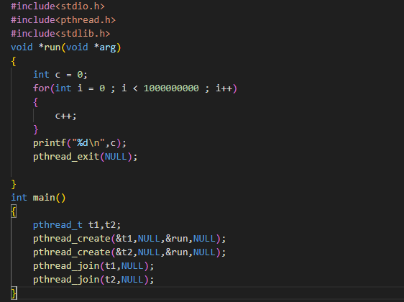
Example

Slide 17

Example(cont.)

Slide 18
Example: Pass Argument During Thread Creation
int pthread_create(pthread_t *thread, const pthread_attr_t *attr, void *(*start_routine) (void *), void *arg);
pthread_create(&thread, NULL, &run,(void*)&tmp)
void* run(void *argu){
int n=*(int*)(argu);
print(”%d”,n);
}

Slide 19
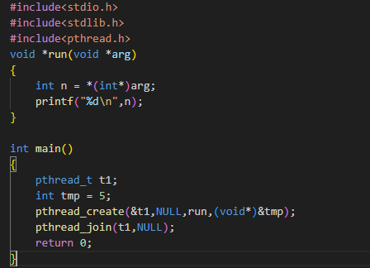
Example

Slide 20
Example(cont.)

Slide 21
Outline
Thread Overview
POSIX Thread
- Creating Threads
- Exit threads
- Join threads
Exercise

Slide 22
Homework Assignment #2
Exercise – Matrix multiplication by multi-thread
Using the API we learned above mentioned.
Create two Matrices,and the size of Matrix should be dynamic.
For every row multiplication,we need a single thread to calculate sum.

Slide 23
Homework2: Create Threads for Matrix Multiplication
Creating a number of threads to perform matrix multiplication

Slide 24
Requirements
Input in the size of matrix A where matrix A’s size is mxn
Input in the size of matrix B where matrix B’s size is nxp
Input the two matrices A and B
Perform matrix computation : A*B = C (output)
Main thread creates m thread
Each child thread derives one row of C
After all children threads complete, main thread print the output matrix C

Slide 25
Example
Thread 1
Thread 3
Thread 2
1
2
3
1
2
3
30
36
42
5 6
7 8 9
5 6
7 8 9
=
66
81
96
102
126
150

Slide 26
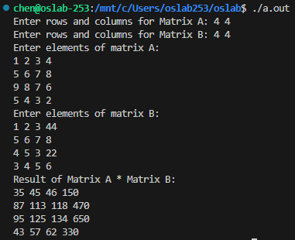
Homework Assignment #2
Example
A = 2 x 3 , B = 3 x 2
[ ]
[ ]
1 2 3 44
5 6 7 8
4 5 3 22
3 4 5 6
1 2 3 4
5 6 7 8
9 8 7 6
5 4 3 2
A =
B =
[ ]
[ ]
[
]
1 2 3 4
5 6 7 8
9 8 7 6
5 4 3 2
1 2 3 44
5 6 7 8
4 5 3 22
3 4 5 6
35 45 45 150
87 113 118 470
95 125 134 650
43 57 62 330
=

Slide 27
Turn in
Deadline
2025/11/25 PM.11:55:00
Upload to iLearning
File name
HW3_ID.zip (e.g. HW3_4106056000.zip)
Source code
.c file
screenshot of the result
(A : 3*4、B : 4*5)

Slide 28
TA
Name：Wei-Xuan Nee
Email：niweixuan0418@gmail.com
Lab：OSLab (1001)

